Slide 1


Slide 2
Environmental Justice
Our environment and the whole of Creation has as much right to live freely and happily and for them to be as they are intended to be.
Their Role and Responsibility towards Life and Well being on Earth is vital which without we cannot survive.
Therefore, we must treat and use our Natural Resources with due Care, Respect and diligence as their Capacity and Capabilities to cope with Stress and Abuse is limited just as we Humans do.

Slide 3
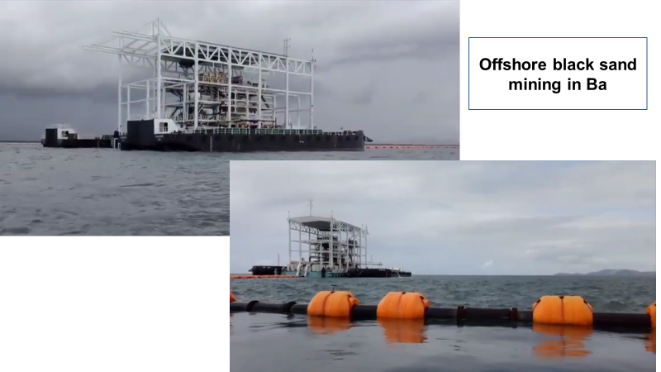
Black sand mining in Fiji.
Votua,foreshore, ba – Fiji.

Slide 4
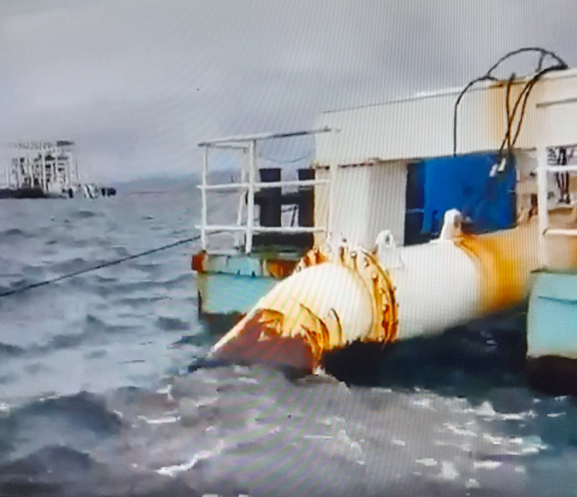
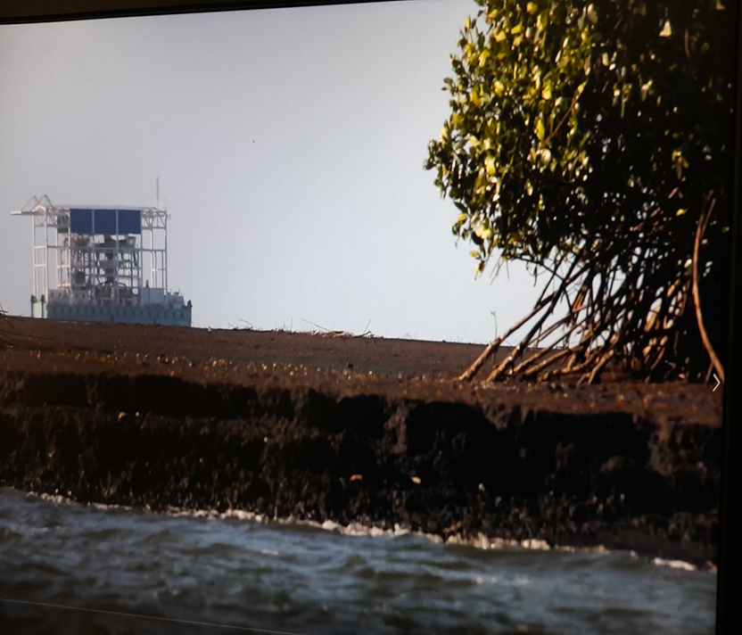
Vulnerable and vital ecosystem.

Slide 5
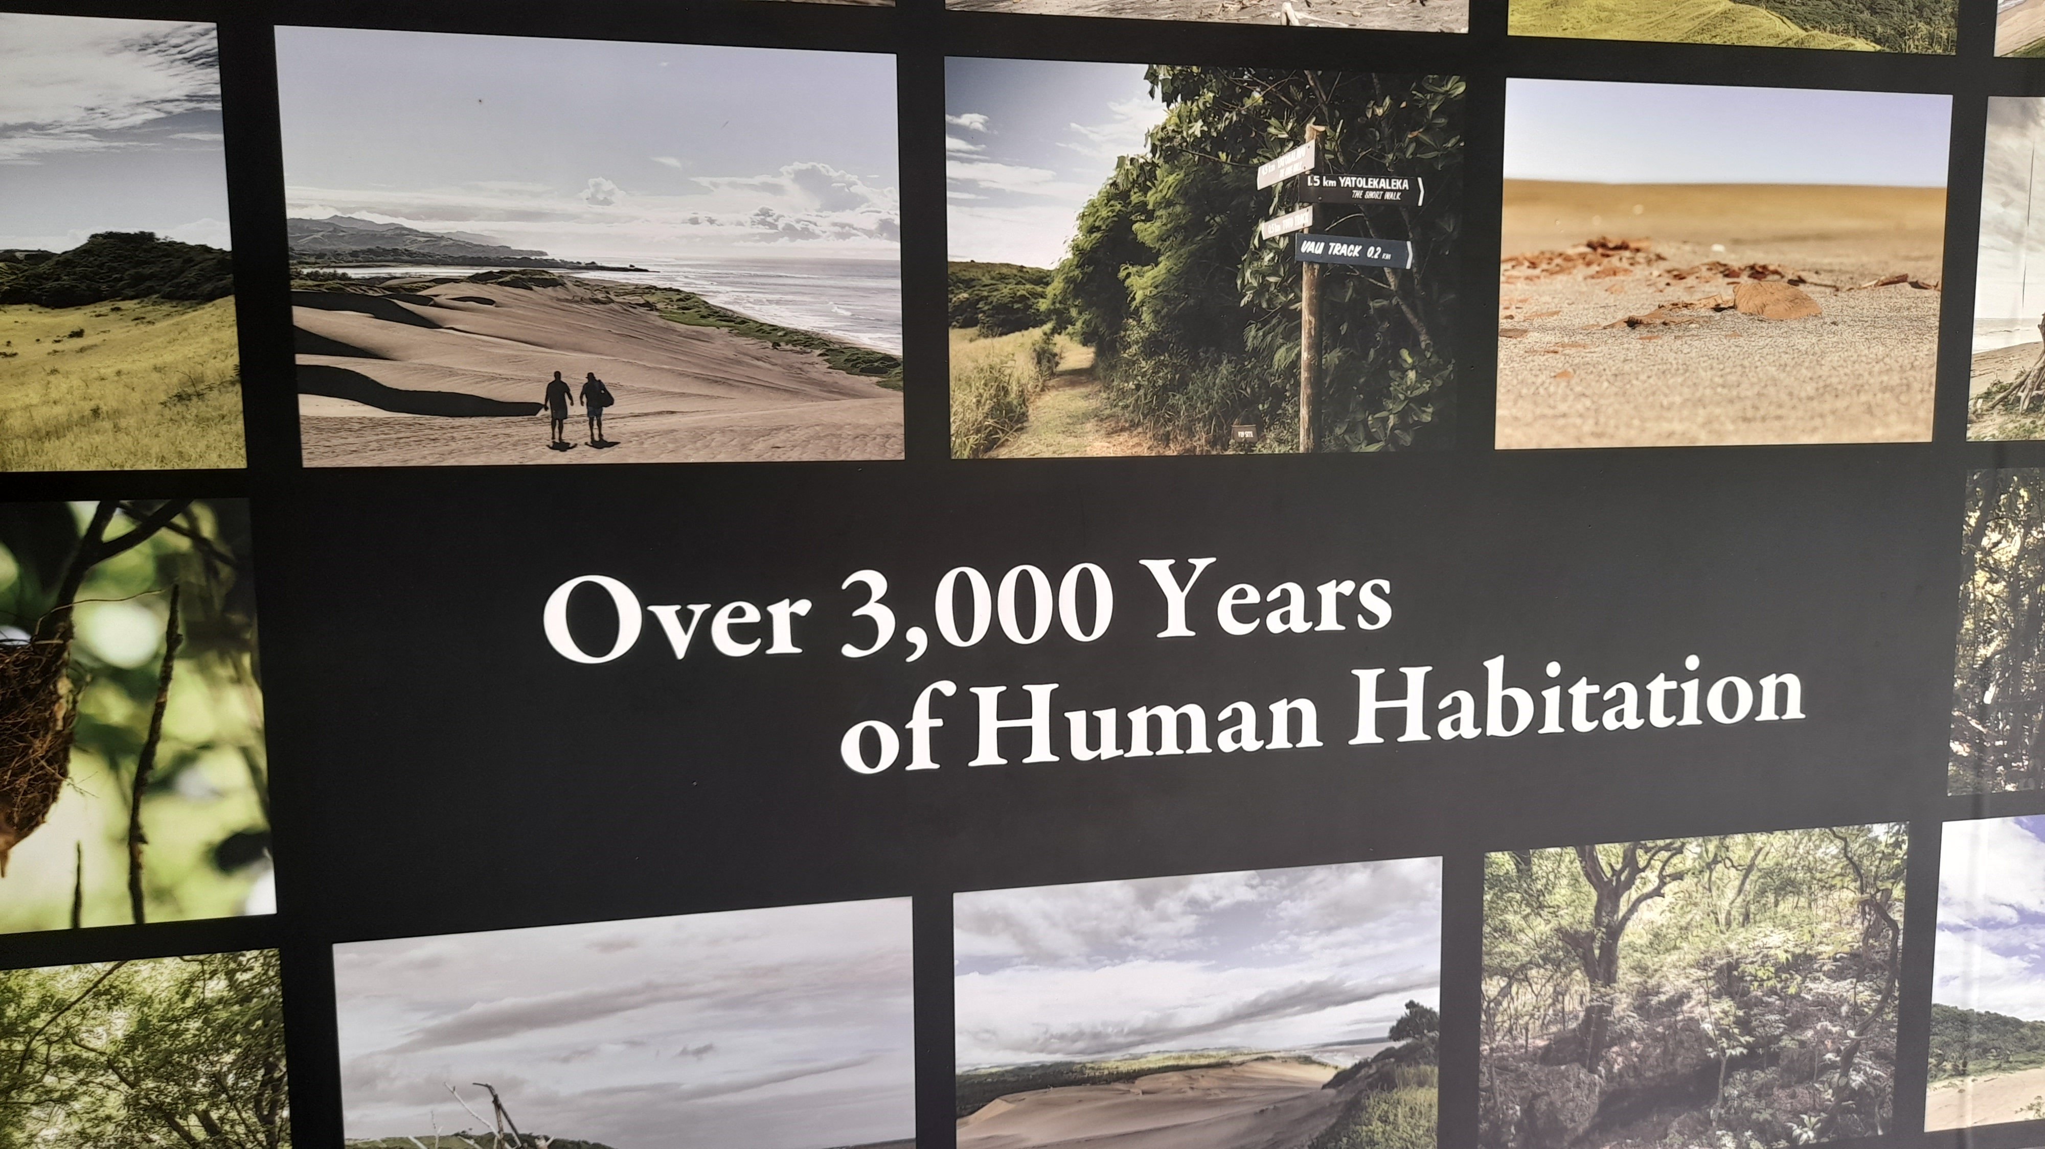
Sigatoka sands dunes.

Slide 6
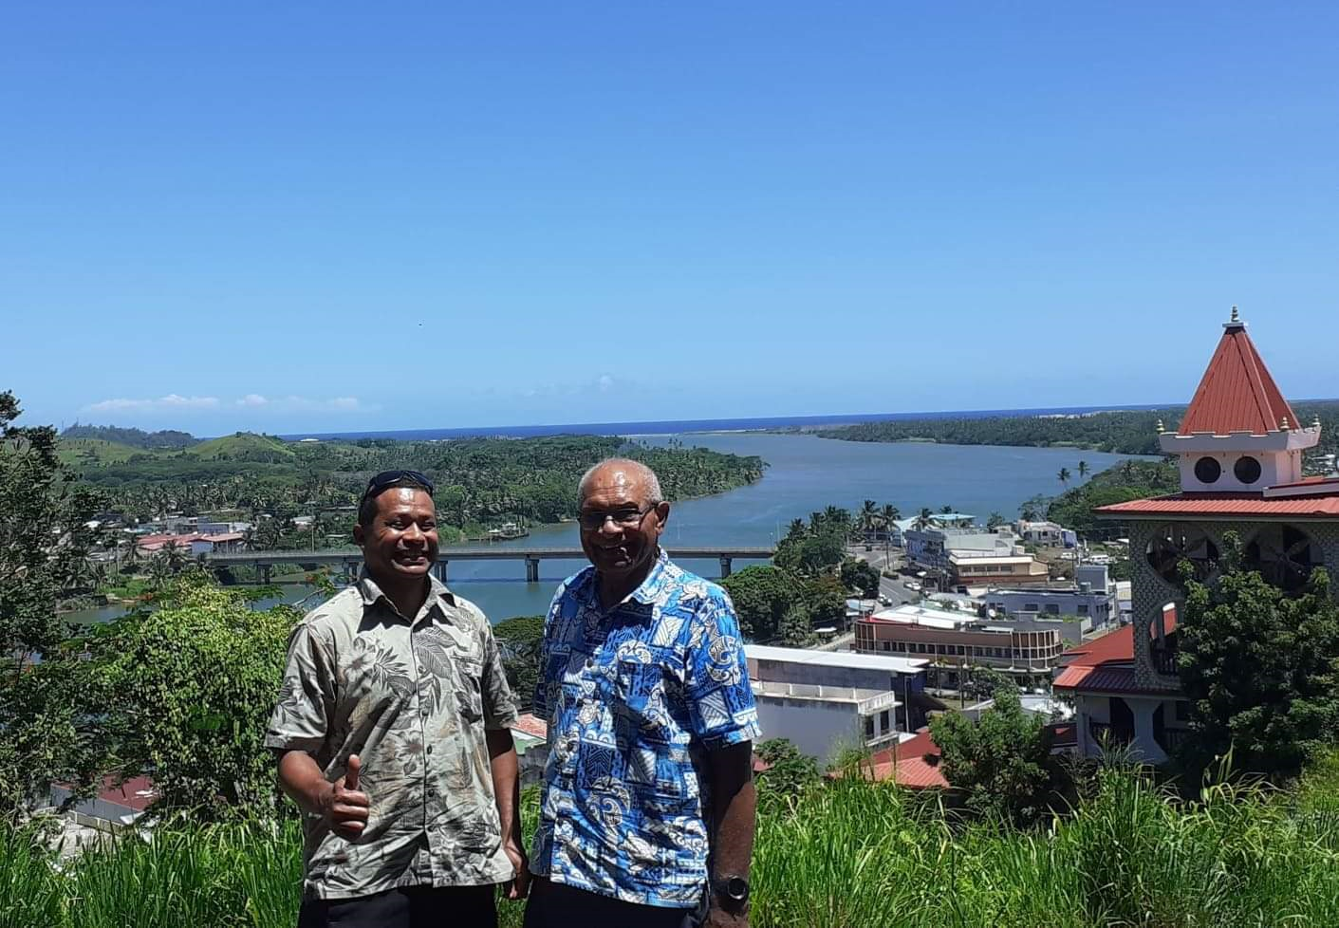
The area under prospect sigatoka.

Slide 7
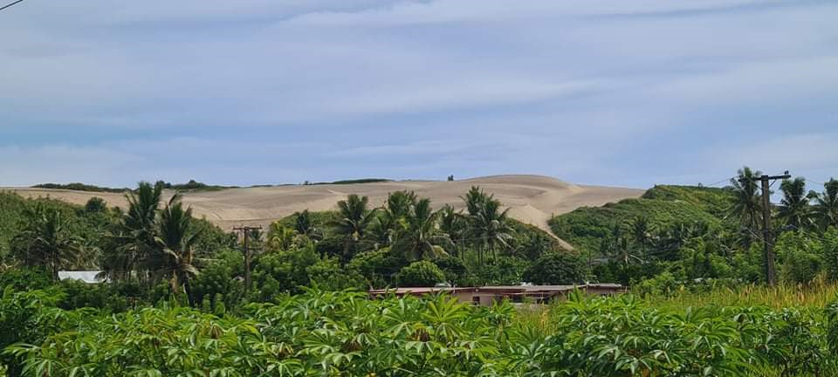
Sigatoka sand dunes.

Slide 8
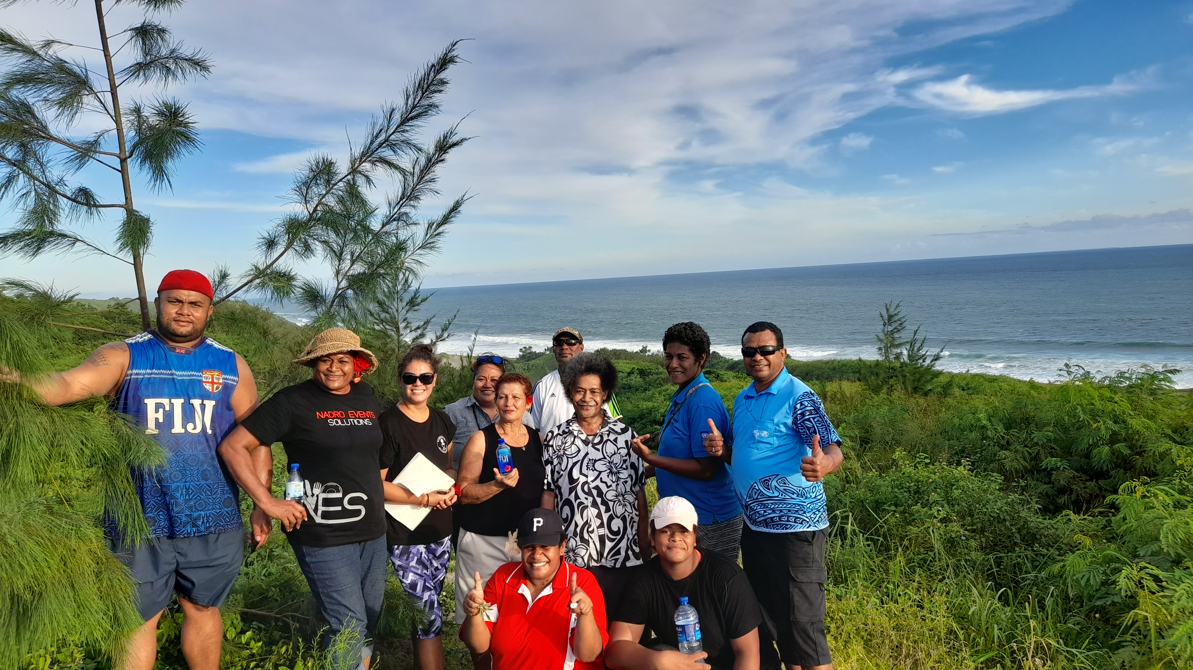
Our Oceans is connected to us

Slide 9
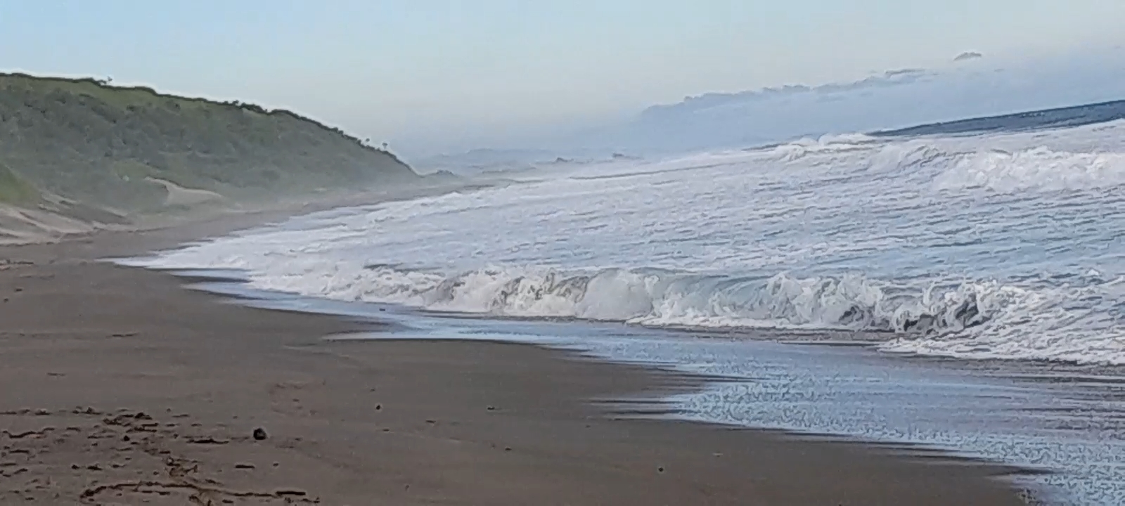
Sigatoka Diverse ecosystem

Slide 10
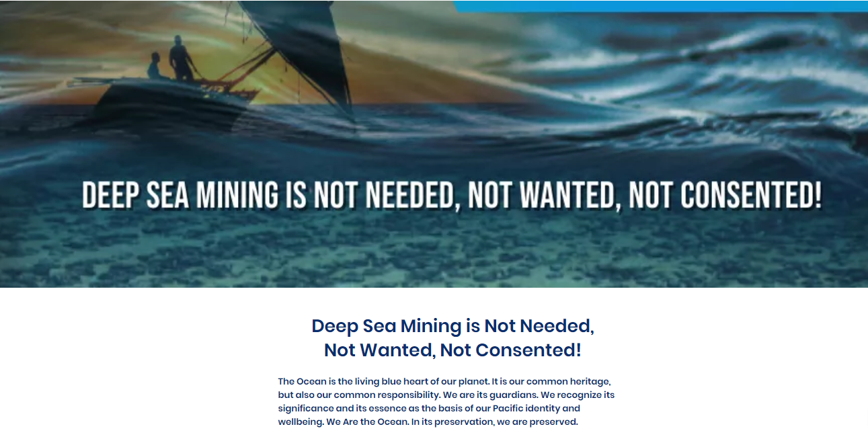
We must not harm her. We are the people of the oceans.

Slide 11
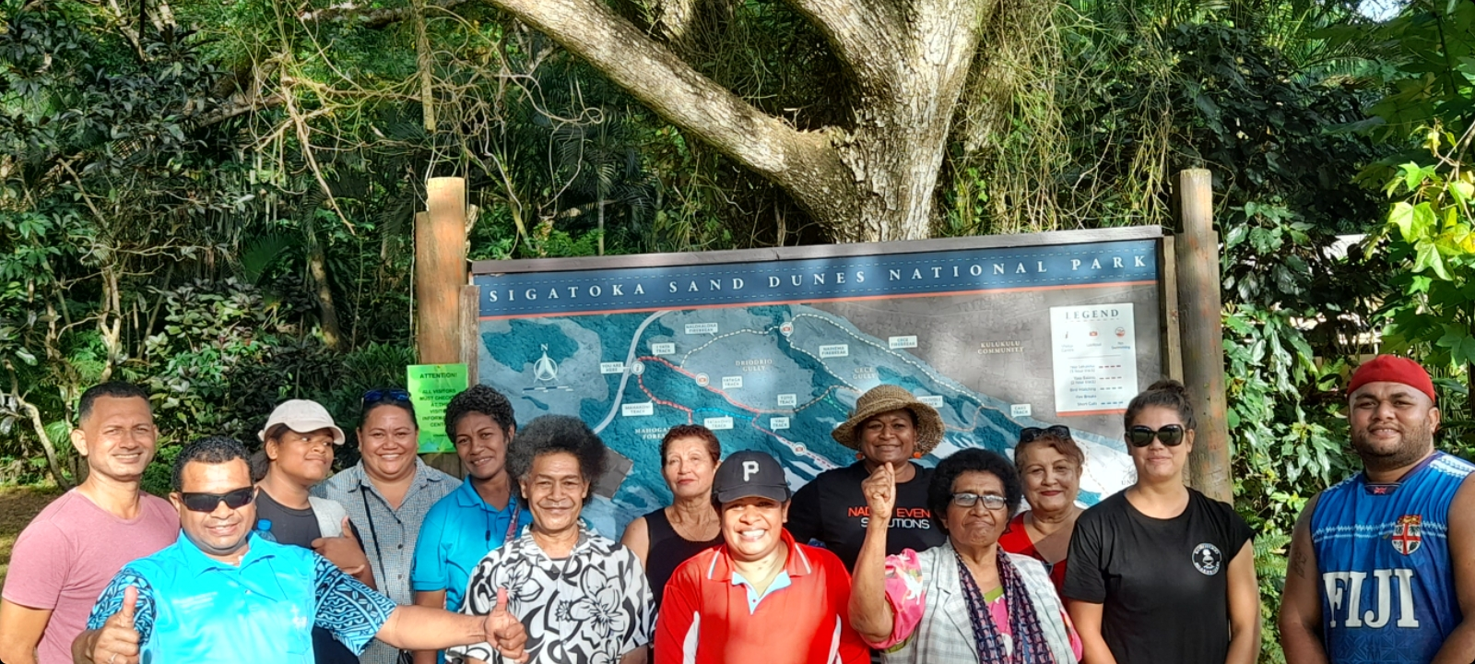
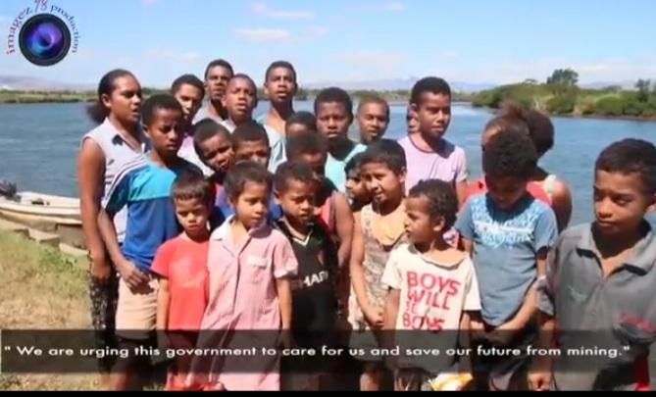
Our own integrity and future is at stake if we do not stand and defend our land.
Sigatoka Defenders
Children of Votua in Ba speaking up.

Slide 12
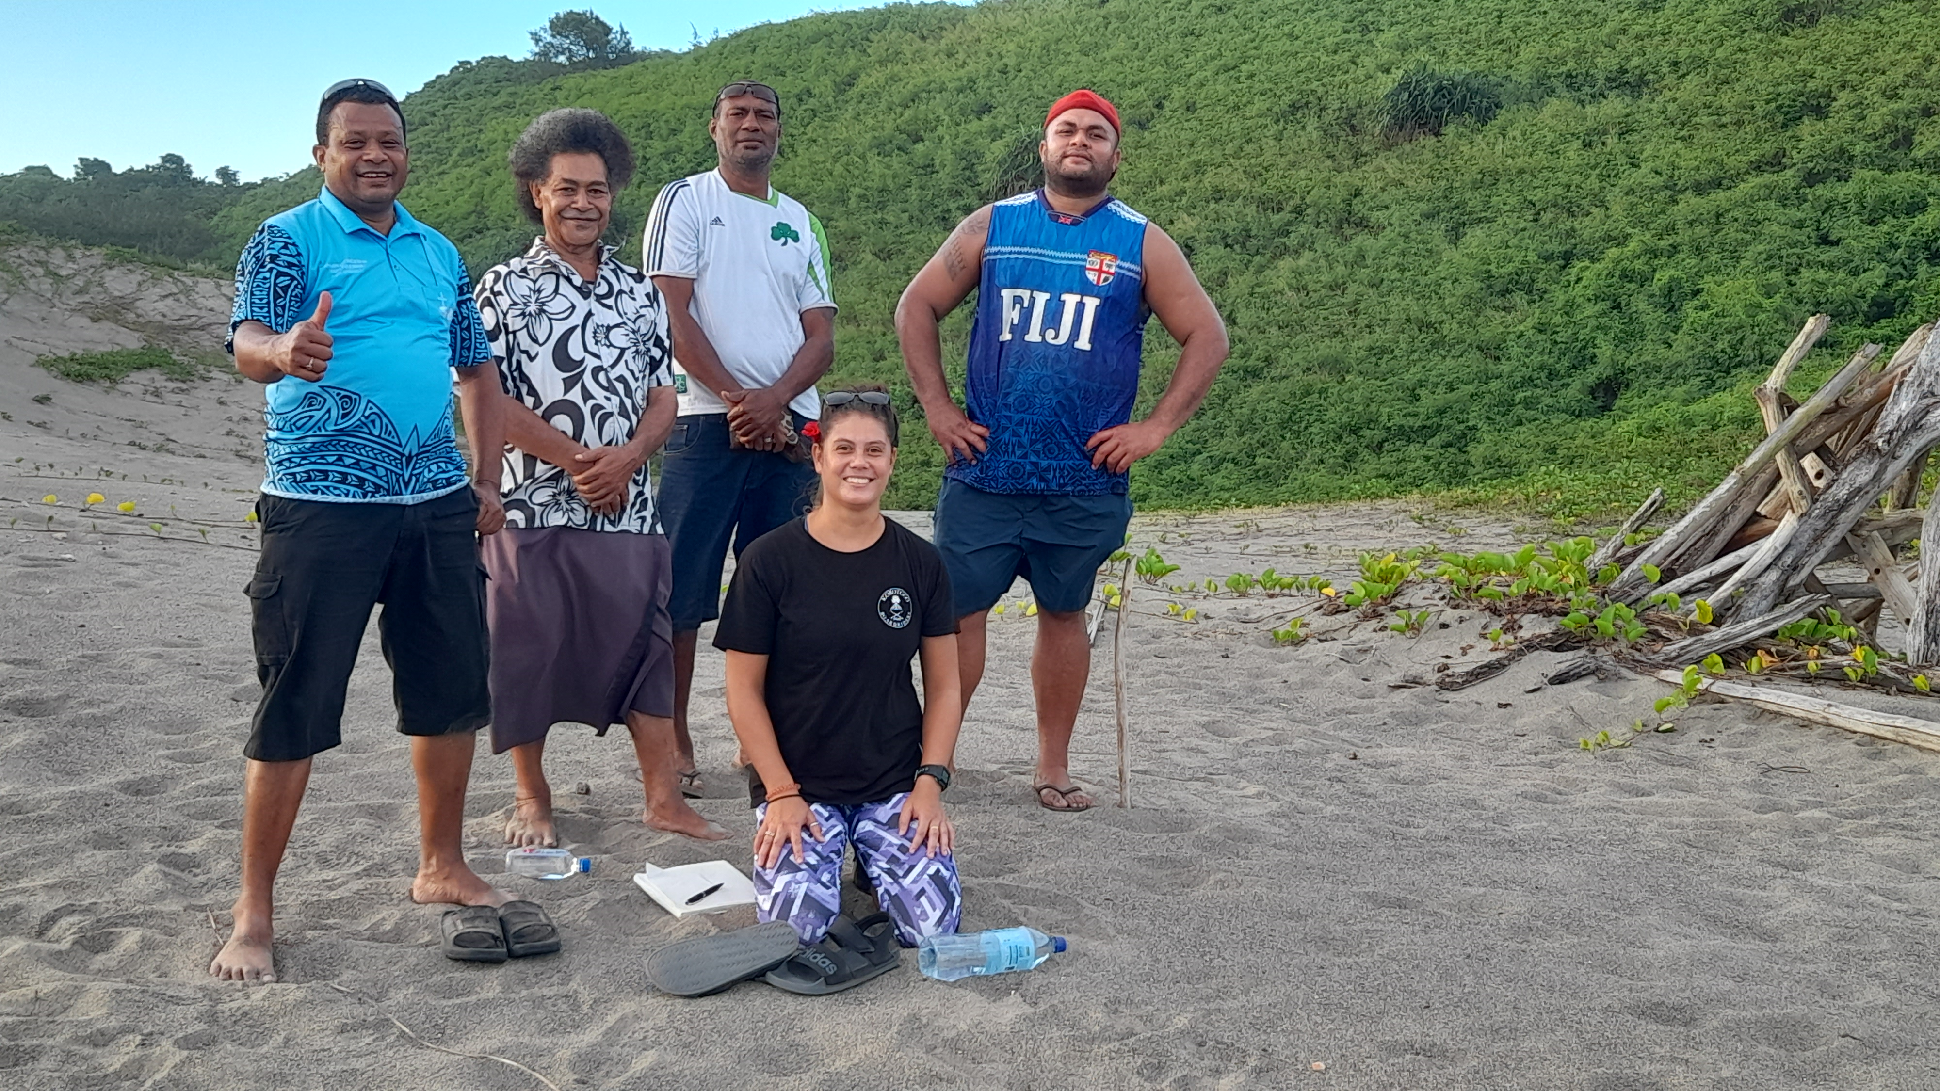
It is our duty to protect all life

